Slide 1
Responding to diversity

Slide 2
program
Introductions
Supporting diversity: aims of our program
Working with students from other language backgrounds
Underpinning pedagogy
Inclusive teaching
Co Teaching in Common Units

Slide 3
Your experience?
What was your experience of uni as a first year student?
What was the student cohort like, environment, teaching?
From: www.cps.k12.in.us
Notes:
Groups Discuss (5 mins) report back

Slide 4
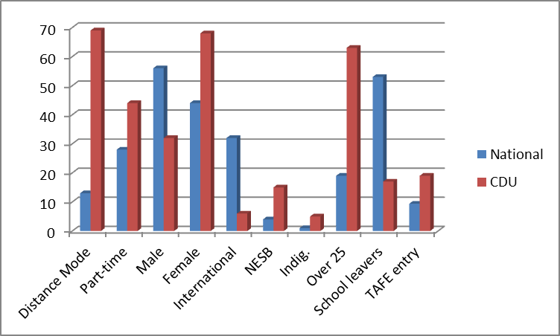
First some context: High non-traditional Demographic at CDU – Figures 2014
High numbers of
non-traditional & low SES students:
External, P/T, NESB,
Mature Age, Alternative entry
Notes:
2011 figures. High external now close to 70%, high part-time, higher female 68%, high NESB, higher Indigenous, only 16% school leavers and 21% under 25, 18% VET entry 10% higher than australian average

Slide 5
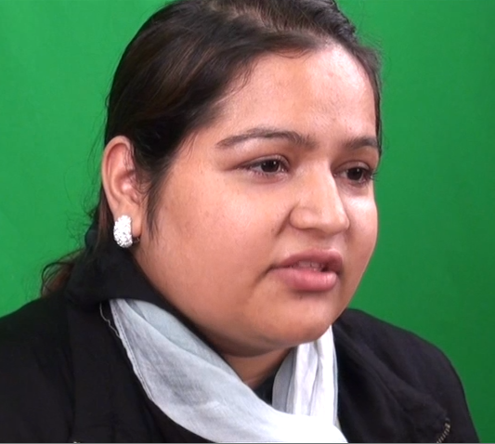
DiversIty = Diverse needs and Experiences
Sam
Puja
Corinna
http://orientation.cdu.edu.au/content/becominaunistudent.html
Notes:
10 mins

Slide 6
Variables effecting students success at university (Tinto 1997, James et al 2009)
Age
Part time status
Motivation
Academic literacy
Students
Study mode
Personal circumstances
Initial achievement
Course experience
Right choice of course
Integration into learning community
Literacy/educational background
Notes:
(Baldwin 2008, Tinto 1987, Glossop 2002, Last and Fulbrook, 2003 etc, First year expereinec, James et al, CSHE )
Difficult to isolate success in grades and retention to a single factor

Slide 7
Factors which affect language and literacy levels of PRETERTIARY and first year university students in Australia
Demographic differences
Entry path to higher education
Engagement with literacy
Proficiency in languages other than English
http://www.northernstar.com.au/news/mentors-to-guide-students-aime/1408687/
Notes:
Demographic differences
Entry path to higher education (Year 12, VET, TEP, Other)
Engagement with literacy (in any language)
Proficiency in languages other than English

Slide 8
students who speak English as a second or another language
Indigenous Australians
First and second generation migrants to Australia
International students
http://www.theaustralian.com.au/higher-education/australia-reaches-35-attainment-oecd/story-e6frgcjx-1226136934637

Slide 9
Differences in languages which challenge
Differences in a student’s first language including:
Phonology
Spelling (Orthography)
Grammar (Syntax)
Vocabulary (Semantics)
Language usage (Pragmatics)
can impact on how well a student can be understood in oral and written communication, and how easily they can understand spoken and written English.
http://palmstone.com/portfolio/index5.html

Slide 10
language acquisition is an ongoing process
A language test can elicit what a student can do in a particular language, in a particular context but also demonstrates a stage in the process of building language competence.
Implications?
http://www.ets.org/toefl
http://ieltswithmiryana.wordpress.com/
Notes:
Minimum requirement for International students = IELTS 6.0
Minimum requirement for students whose first language is other than English is TEP, or VET Diploma, or Year 12 including a pass in ESL

Slide 11
IELTS – A University Entrance Test for International Students
Descriptors of the IELTS – Levels 4 - 9
Notes:
Could provide samples from https://www.ielts.org/-/media/pdfs/113313_ac_sample_scripts.ashx?la=en – gives written samples for 5, 6 and 7 scores.

Slide 12
What about Students who Aren’t international?
Other students who speak English as an additional language may enter university through a bridging/enabling program, VET, special studies program or year 12, include:
Indigenous students
First and second generation migrants
None of these programs are designed to directly address a student’s developing English language skills or prepare students for the language demands of university.

Slide 13
Alternative Pathways to University
Students from diverse demographic backgrounds who do not speak English as an additional language may also enter university through a bridging/enabling program, VET, special studies program or year 12 and may also have very different experiences in the way language and literacy is used in their community and/or family.
http://naturalawakeningsnnj.com/blog/2018/02/01/thriving-transitional-times-community-discussion-group/

Slide 14
Studying at university
“To study independently, university students must be able to read complex academic texts with a high level of understanding, and be able to critically analyse such texts in order to present coherent analysis, argument or discussion in their own written work. They must also be able to structure their essays appropriately, using academic conventions and objective academic language, to demonstrate their mastery of a topic or inform and influence their readers” (Rose 2006, p42).

Slide 15
The academic challenges first year students Face?
Consider:
This assessment task for CUC107 and associated reading.
To what extent students with an IELTS 6 and IELTS 5 will need language support?
To what extent your other students might need language support?
From: www.cps.k12.in.us

Slide 16
The needs and challenges for supporting our students?
Reflecting back on our discussion so far, sum up the overall challenges for you in teaching students from diverse backgrounds? for:
- students and
- for you
From: www.cps.k12.in.us

Slide 17
Supporting our students to succeed: Advice for University teachers from Devlin et al 2012
From: www.cps.k12.in.us

Slide 18
How Common units support Our students to make the transition
The program aims to develop:
Practical academic skills, including, critical thinking, reading, researching and writing
Teamwork skills, creativity and technical literacy
Cultural intelligence and capability for effective participation in the increasingly diverse communities
Graduate attribute skills, including personal practical knowledge, citizenship and world view
Understanding of theoretical and practical aspects of university culture

Slide 19
In first year students complete
One literacy common unit:
CUC100 Academic Literacies (for humanities and social sciences
or
CUC106 Design & Innovation:Communicating Technology (for Business, technology, science)
and
CUC107 (introducing cultural knowledge)
Notes:
This progress will continue to escalate as their confidence and skill grow through studying there other units.
The common units represent the students early steps in becoming academics - it is in third and fourth year that we can expect them to have perfected many of these skills not by the end of 12 weeks with us.

Slide 20
Relevance through multidisciplinarity
Content references all disciplines
Teaching teams drawn from different schools
Management group includes representatives from faculties and schools

Slide 22
recognition of our diverse demographic informs our approach:
Responds to students' changing needs through continuous reflection and review of the program
Commits to a supportive, developmental and flexible approach to teaching and learning
Provides a comprehensive management strategy with guidelines and support for teachers for learning and teaching practice
Notes:
we adopt in the Common Unit Program

Slide 23
Key practices that reflect philosophy
Assessment that:
Is formative and developmental
Allows students to perfect and develop their skills as they go through the course
Is fair and designed to take into account students diverse educational and cultural backgrounds
Notes:
23

Slide 24
We scaffold students learning by:
Working from manageable levels to gradually harder with support.
Allowing students to resubmit assignments so they can learn by addressing problems
Understand that for some students reaching the bare minimum standard by the end of the units will represent significant progress
Notes:
This progress will continue to escalate as their confidence and skill grow through studying there other units.
The common units represent the students early steps in becoming academics - it is in third and fourth year that we can expect them to have perfected many of these skills not by the end of 12 weeks with us.

Slide 25
Encapsulating these principles
A supportive, flexible and development approach
http://learnline.cdu.edu.au/commonunits/students.html
Student administration consistent with our philosophy http://learnline.cdu.edu.au/commonunits/managing.html
Clear expectations of staff for best practice learning and teaching http://learnline.cdu.edu.au/commonunits/teaching.html

Slide 26
Our Learning and teaching approach is underpinned by:
Authentic, Experiential and Collaborative pedagogy so …
Learning experiences should consider students learning styles and backgrounds, and facilitate learning through authentic, meaningful and purposeful collaboration with peers and teachers.
Notes:
.
g
Kolb, (1984) defines experiential learning as "the process whereby knowledge is created through the transformation of experience. Knowledge results from the combination of grasping and transforming experience.“

Slide 27
What does this really mean?
collaborative experiential
authentic
student focussed
Enquiry based
Notes:
What do these terms mean to you – give an example from your own practice

Slide 28
definitions
Collaborative - term for a variety of approaches in education that involve joint intellectual effort by students or students and teachers.
Experiential - is the process of making meaning from direct experience, i.e., "learning from experience“ – that includes sufficient experience/practice to master skills)
Authentic - real life learning that encourages students to create a tangible, useful product to be shared with their world.
Student centered - is focused on each student's interests, abilities, and learning styles, placing the teacher as a facilitator of learning.
Enquiry based - starts by posing questions, problems or scenarios to be resolved-- rather than simply presenting established facts or assuming a passive path to knowledge.
Notes:
Where does chalk and talk fit in?

Slide 29
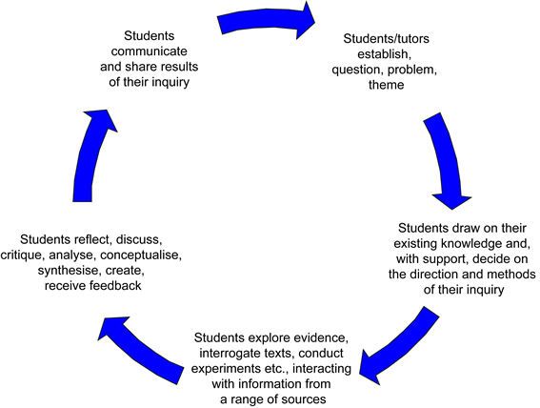
Cycle of enquiry based learning in CU workshops
From: http://www.qub.ac.uk/directorates/media/Media,249724,en.jpg

Slide 30
Building mutual respect, Engagement and successful learning (H0dson, 2017)
Some student comments – S.1 2017
Read the account of Zoe’s class room and identify the practices encouraged students:
Feeling of inclusivity
Trust in themselves, the teacher and each other
Motivation and engagement
Collaboration
Confidence
From: District Administration Magazine

Slide 31
Reflecting on positive affect in the classroom – Did I?
Greet students warmly as they arrived?
Outline the purpose and focus of the class?
Facilitate students engagement?
Encourage all students to participate in discussions?
Give sufficient time for answers?
Link together ideas?
Maintain a calm, supportive presence ?
Encourage support, equality and inclusiveness through my actions, words and body language?
Observe, reflect on how students were responding to throughout the class and make adjustments accordingly?
Adapted from: Hodson 2017

Slide 33
Supporting students academic language and literacy development
Academic texts are highly specialised and dense.
So,
Teaching in the Common Units involves teaching students how to recognise how meanings are made in texts.
Then,
They can make use of this knowledge in academic tasks.
http://steve-wheeler.blogspot.com.au/2010/06/scaffolding-or-no-scaffolding.html

Slide 34
An Apprenticeship Model
Learning to read and write academic texts takes time and practice.
So
Our teaching for first year students and beyond should be seen as an apprenticeship model – this means scaffolding student learning.
This involves supporting students in the acquisition of literacy, giving students time to practise complex skills.
http://investingcaffeine.com/tag/bubble/

Slide 35
Tying students in knots
Here is some string, here is what we want you to do with it
https://www.animatedknots.com/bowlinebight/index.php

Slide 36
Scaffold reading texts – don’t leave them to struggle and Fail
Prepare for reading – discuss the reading content in everyday language and encourage students to draw on what they know already
Create a taxonomy of the structure and key ideas of the text with the students – a visual map of the content
Do a detailed reading of just the relevant sections – unpack key terms, help them identify the important ideas for their purpose
Extract key ideas and model how to
paraphrase these by rewriting as a whole group.
Watch out for the workshop on this!
http://www.bendigotafe.edu.au/Courses/fees-and-charges/Pages/get-help-with-fees.aspx
Notes:
Prepare for reading: This means giving relevant background information to the text as well as an overview of the reading – its structure and content.
Create a taxonomy of the text with the students
Do a detailed reading = This means elaborating on meanings and drawing students’ attention to text patterns
Make notes of key ideas and paraphrase these
Summarise each section, and what was covered.
Write key points on the board.
Give students opportunities to discuss the ‘why’ questions … Why is the writer saying this? Why do you think …

Slide 37
Supporting all students in the classroom
In class
Provide a clear overview of a lecture or workshop and what will be covered, and at the end, give a summary of what was covered
Provide lecture notes and/or power points of key points
Speak clearly and slowly enough
On-line
Provide clear visual teaching aids to support lectures or discussions
http://blog.simplek12.com/education/engage-students-online/

Slide 38
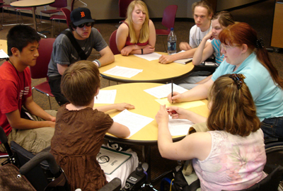
Supporting All Students in the classroom
In group discussions
Give students enough time to organise their thoughts and speak to each other, and record their ideas.
Check to see less confident students have a chance to speak
In class discussions
Summarise what was said, and note down the main points on the board where possible.

Slide 39
assessment and feedback Juah et als (2004) formative approach
1. Facilitates the development of self-assessment (reflection) in learning.
2. Encourages teacher and peer dialogue around learning.
3. Helps clarify what good performance is (goals, criteria, expected standards).
4. Provides opportunities to close the gap between current and desired performance.
5. Delivers high quality information to students about their learning.
6. Encourages positive motivational beliefs and self-esteem.
7. Provides information to teachers that can be used to help shape the teaching

Slide 40
Following Juah et al: Supporting Students’ learning through Assignments
Interpretation of assignments | Ask for a plan and check drafts (or partial draft) to ensure students understand the purpose, expectations and structure of assignment.
Giving feedback | Be instructive and specific in your comments. Prioritise comments on content and structure. Be clear about how students will be assessed.
Critical Thinking | Help students to expand on what they have said by asking: Why are you saying this? Why do you think … Why do you think the author has said this …
Coherence and reference | Be explicit about where clearer coherence is needed and further explanation and examples. Revise one or two paragraphs as an example of good connectives, showing how cohesion is achieved.

Slide 41
Supporting Students with assignments
Logical Progression | Clarify where parts of the writing should be e.g. thesis, reference details, cohesive markers …
Stylistic devices | Explain if particular aspects not appropriate e.g. flowery or verbose language, emotive or exaggerated claims or generalisations, use of analogies, metaphorical language
Evidence | Be instructional about what constitutes acceptable or ‘good’ evidence and what does not Clarify any issues with referencing details
Correcting grammar and language Remember | Decide what is tolerable ‘writing accent’ Where there are systemic errors, provide notes at the end and any relevant references.’ If non systemic errors do not interfere with meaning, there is no need to correct them, with the exception of the article or prepositions Correct idiomatic use, errors in collocation, and alternative words/phrases is language used is not accurate Overcorrection of grammar and language use is not usually instructive.

Slide 42
Supporting students with assignments
Be clear about your expectations of students | Use a clear, unambiguous assessment criteria to mark students’ work. Participate in regular moderation workshops with other teaching staff to ensure that you are fair and consistent in your approach.
Final Comment | Be positive with the student’s efforts, telling them what they have done well. Explain any specific problems , and finish by again affirming what they have achieved.

Slide 43
Example comment – kiss kick kiss
Hi Jane
In general you have made a great attempt at summarising and paraphrasing these readings.
As you will see from my comments within your assignment you have at times slipped into informal language – remember no personal pronouns (e.g “I” and “you”) in academic assignments unless they are asked for specifically. You could also have developed your comments on the readings a little further to talk specifically about why the ideas were relevant or not to your profession.
Overall though you have presented your annotated bibliography correctly and captured the key ideas well.
Cheers
Nicola

Slide 44
Considering our expectations of students assignments and what are these based on?
By the end of first year, what do you expect
students to be able to do in relation to?:
Acquisition of knowledge: How independent should they be as learners?
Knowledge Base: What do you expect them to know?
Application: How effectively and broadly should they be able to apply this knowledge?
Creativity: How original and/or innovative should their ideas be?
Communication: What do you expect them to be able to do in spoken and written tasks? (Consider language criteria)
Team Work: How well should they be operating in a group context?
Notes:
What do we base our expectations on- are they realistic?

Slide 46
Defining co-teaching
Co-teaching is an approach where two professionals deliver substantive instruction to a group of students within a single physical space (Cook & Friend, 1995).

Slide 47
Co Teaching – the common Unit Way
What we mean by co teaching in the CU’s
Elearning Studios
Two people facilitate a class at the same time
One person leads the material at a time
Both facilitate and support students learning activities
Anything else?
From: http://storytrail.com/Impact/Chapter_5/main1.htm

Slide 48
Background to co-teaching in common units
CU's unique in team teaching
Came out of ELearning studio size
Has advantageous and disadvantages for staff and students
Has an incidental peer review opportunity
Important to create a safe and effective culture for teaching and peer review

Slide 49
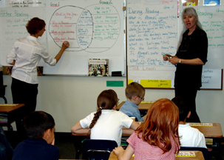
Aims of this section
Consider the subtleties and dynamics of co-teaching and per review
Consider guidelines/frame for co-teaching
Plan for review and reflection
From: http://storytrail.com/Impact/Chapter_5/main1.htm

Slide 50
Benefits and challenges of co-teaching
For Student’s?
For you as co-teachers?

Slide 51
Co-teaching advantages
Richer resources for learning and teaching
Students are exposed to different ways of thinking
Allows more experiential, supported learning
Easier to build relationships with students
Sharing of learning and teaching practices
Incidental peer review through feedback and reflection with co-teacher

Slide 52
Guiding practices adapted from Conderman & McCarthy 2003
Reserve time for communication and reflection.
Develop a sense of safety through building trust.
Foster an environment that promotes a spirit of parity -contributions equally valued, equal decision-making power.
Get acquainted with your collaborator’s teaching style.
Identify strategies to deal with power/potential conflict.
Conduct careful reflection and class planning.
Be present and engaged in all class sessions.
Model modes of inquiry, debate/dialogue with your collaborator.
Plan and anticipate, but remain flexible to respond to evolving course needs and opportunities emerging from the co-teaching dynamic.

Slide 53
EStablishing Guidelines and Safeguards
Using the template with your co-teacher to share thoughts for:
Allocating roles
Sharing responsibility
Consistent voice
Misunderstandings and conflicts
Planning together
Peer review
Anything else?
From: www.cps.k12.in.us

Slide 54
Final Thoughts
Further workshops later in semester:
Marking, feedback and plagiarism
Scaffolding reading and writing
Any other ideas for PD?

